Slide 1



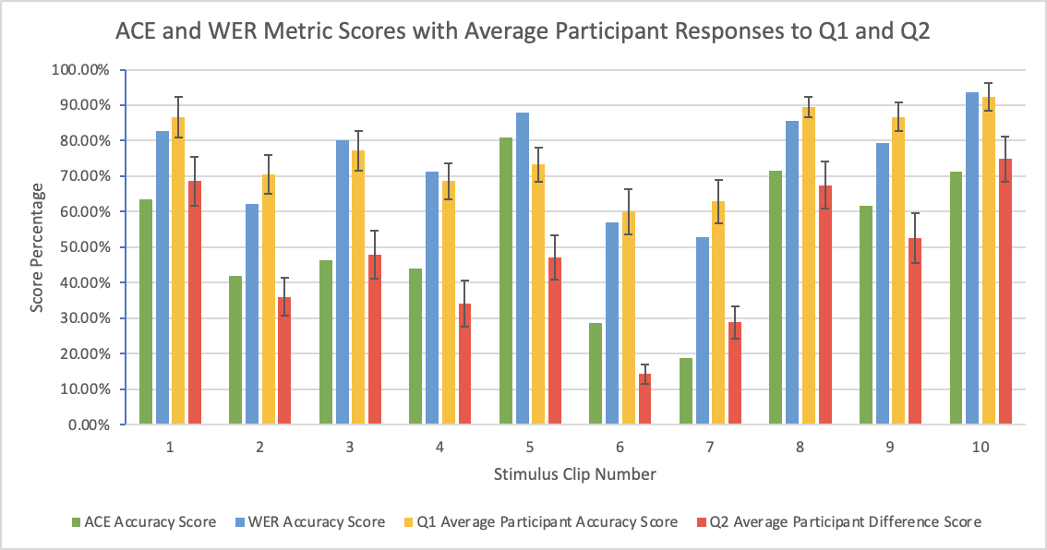
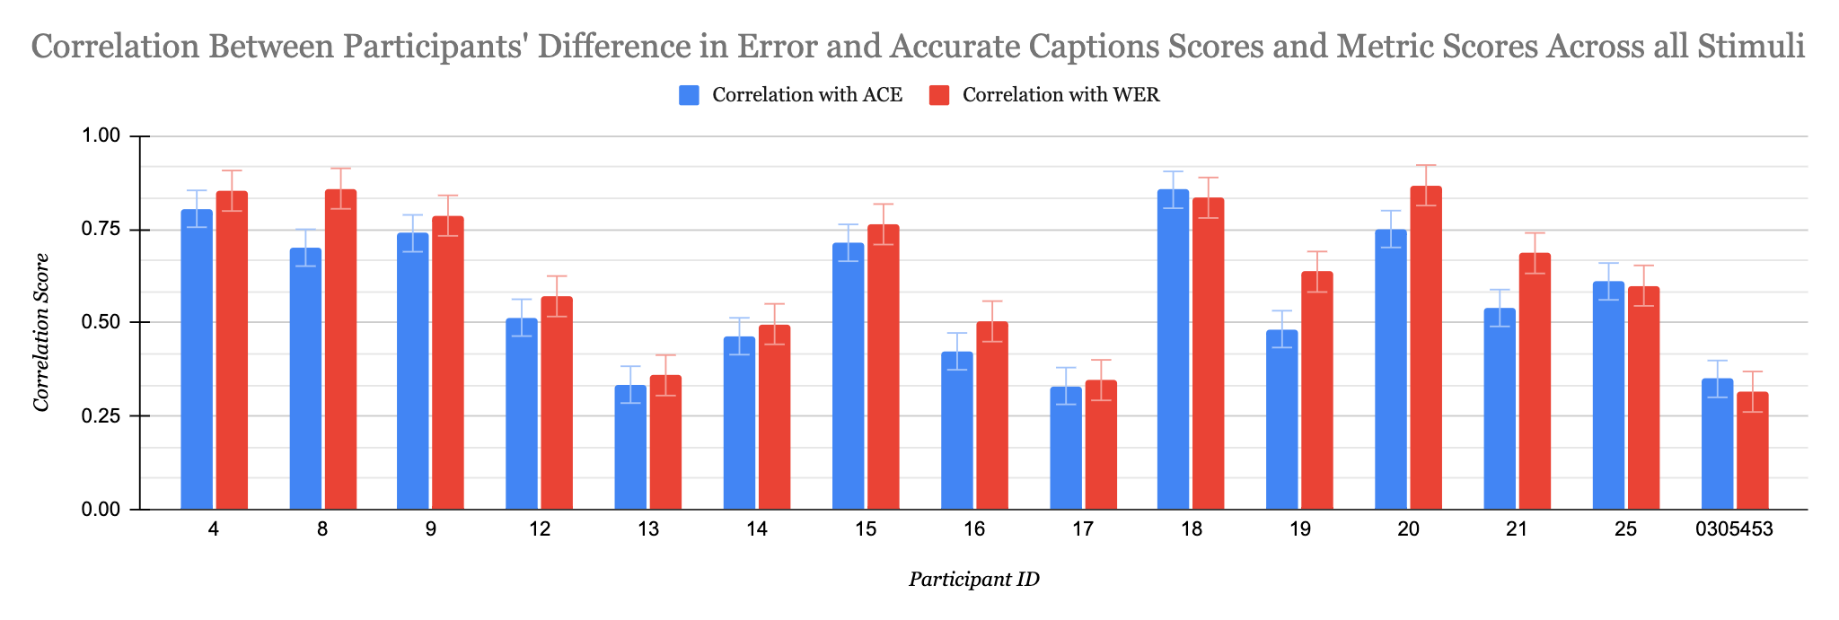
Caption Metrics
REU Accessible Information and Communication Technologies Site, Gallaudet University
Background and Objectives
Figure 1:
Figure 2:
Background: In order to assess the quality of captions, caption metrics numerically compare what is actually spoken (transcript) with the captions. Common metrics include Word Error Rate (WER), Weighted Word Error Rate (WWER), and Automated-Caption Evaluation (ACE), which are helpful for DHH individuals in rating the quality of a captioned video. Although there are many different caption metrics, there is little to no research exploring how these metrics compare to each other. In a 2017 study, researchers compared the efficacy of WER and ACE metrics but the study design was limited in that it was never tested using real-time captioning. There is little research into this topic beyond this study, and there are many disparities in the state of caption quality assessment today for DHH individuals.
Objectives: Our aim is to compare the WER and ACE captioning metrics and assess how well they correlate with quality. We will do this by comparing human perception with automatic measures.
Results
Conclusions
Fifteen people were tested in total. Six deaf, six hearing, and three hard-of-hearing people participated in the study.
We analyzed two data points from participants’ responses. The first question (Q1) being: “Do you feel you were able to fully understand the content of the error clip?” The second question (Q2) asked: “Comparing the original captions and the accurate captions, how would you rate the difference between the two?”
Figure 1 shows the WER, ACE, average Q1, and average Q2 scores for each stimuli clip. Scores in all tables and graphs have been converted to a percentage, where a higher percentage indicates a higher level of accuracy, for readability purposes.
Figure 2 shows the correlation between metric scores and participant understanding scores from Q1. Correlation scores generally are higher for WER and the same trend was observed for Q2.
The WER scores are noticeably higher than ACE across all stimuli. Primarily, we suspect that ACE’s includes word weights, while WER does not. ACE more precisely scores caption errors, which also contributes to its lower accuracy scores overall, since errors are more penalized as a result.
T Tests were performed on the correlation statistics, comparing the WER correlation stats with ACE stats. This was done for both Q1 and Q2. The Q1 T value was 0.077, and Q2 was 0.0030. Q1 was found to have a significant difference between ACE and WER statistics, but Q2 did not.
We were able to conclude that WER has a marginally higher correlation with user experiences than ACE when applied to live TV captioning. However, the means of each correlation analysis are so close that there is little practical difference. We can also conclude that ACE is more sensitive to caption errors than WER, yet our data indicates that error identification does not guarantee an accurate measure of comprehension or quality in live TV captions. Future work should focus on analyzing how the ACE metric weighs errors in captions and how scores can result in overestimation., Future research can expand this work to other metrics such as WWER and NER.
Methods
Set up: In order to curate a set of recordings that could be used as stimuli for our study, we selected 10 clips that would represent a variety of caption errors. Stimuli were clips taken from live segments of ABC 7 News, BBC World News, and CNN News. After selecting the stimuli clips, accurate transcripts of the clips were obtained.
Study: The study was conducted through Zoom and Google Forms. The form included the 10 sets of stimuli clips, each set with error and accurate captions stimuli, as well as questions corresponding to each set. After participants watched both error and accurate clips, they were asked if they felt they were able to fully understand the content of the first clip (from 1 to 7) and to compare the qualities of the error and accurate captions on a scale of 1 to 7 (little difference to big difference). Participants independently repeated this process 10 times.
References
Al Amin, A. (2020). Audio-Visual Caption Evaluation Metric for People who are Deaf and Hard of Hearing.
Kafle, S., & Huenerfauth, M. (2017, October). Evaluating the usability of automatically generated captions for people who are deaf or hard of hearing. In Proceedings of the 19th International ACM SIGACCESS Conference on Computers and Accessibility (pp. 165-174).
Funding
This work has been generously supported by an NSF REU Site Grant (#1757836) awarded to Dr. Raja Kushalnagar, PI and Dr. Christian Vogler, Co-PI.
Contact: Tian Wells & Dylan Christoffels; study2021@captions.us

